Slide 1


(MSAS116)

Slide 2


Understanding Glioma Through Gene Expression
• Aggressive brain tumor with complex molecular behavior
• Diagnosis relies on histopathology
• Gene expression reveals deeper biological patterns
• Need for accurate and reliable classification

Slide 3
Statistical Challenge: High-Dimensional Setting
– Number of features (p) ≈ 54,613
– Number of samples (n) = 180
– Classical “p >> n” problem
p = 54,613 ≫ n = 180
Leads to:
• Overfitting
• Unstable estimates
• High variance
• Curse of dimensionality

Slide 4
Study Objectives
• Identify statistically significant differential gene expression
• Quantify magnitude using effect size
• Apply dimensionality reduction and feature selection
• Compare classification models under cross-validation
• Ensure robustness and reproducibility

Slide 5
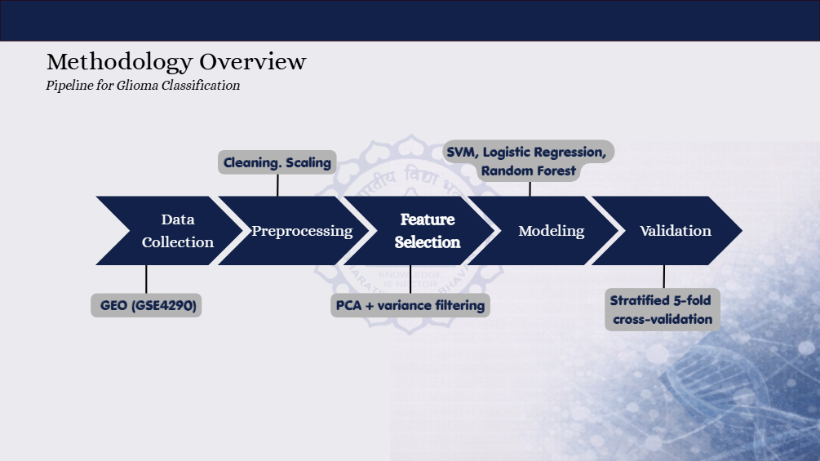

Slide 6
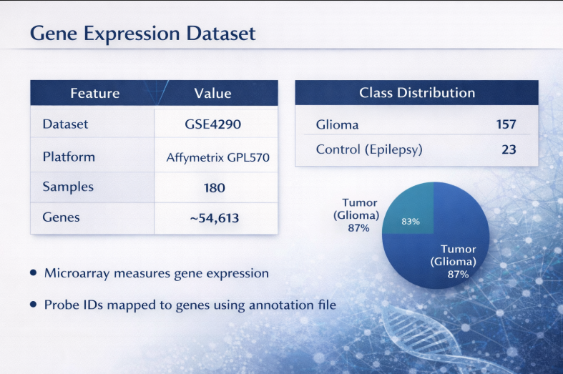
Gene Expression Dataset
• Source: GEO (GSE4290)
• Total Samples: 180
• Glioma: 157 samples
• Control (Epilepsy): 23 samples
• Platform: Affymetrix GPL570
• Features: ~54,613 gene probes
• Microarray-based gene expression data
• Probe IDs mapped using annotation files

Slide 7
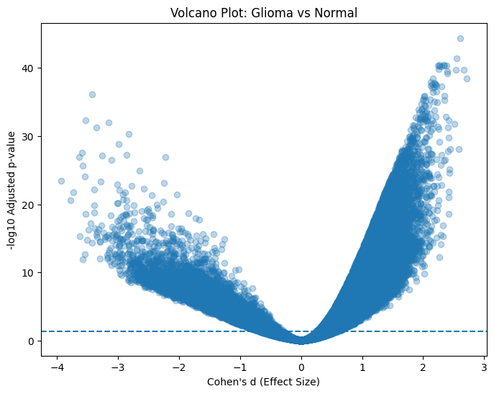
Differential Expression Analysis
• Objective: Compare gene expression between tumor and control
• Method: Welch’s two-sample t-test
• Multiple testing correction: Benjamini–Hochberg (FDR)
• ~29,798 genes significantly different
• Adjusted p-values < 1 × 10⁻⁴⁵
• Controls false discoveries while maintaining power
Top extreme genes show both high significance and large
effect sizes, indicating strong differential expression.

Slide 8
Effect Size (Cohen’s d)
• Statistical significance alone is not sufficient
• Measures magnitude of difference between groups
• Independent of sample size
• Large effect size (|d| > 2) observed
• Indicates strong separation between tumor and control
• Cohen’s d:
d = (x̄₁ − x̄₂) / sₚ

Slide 9
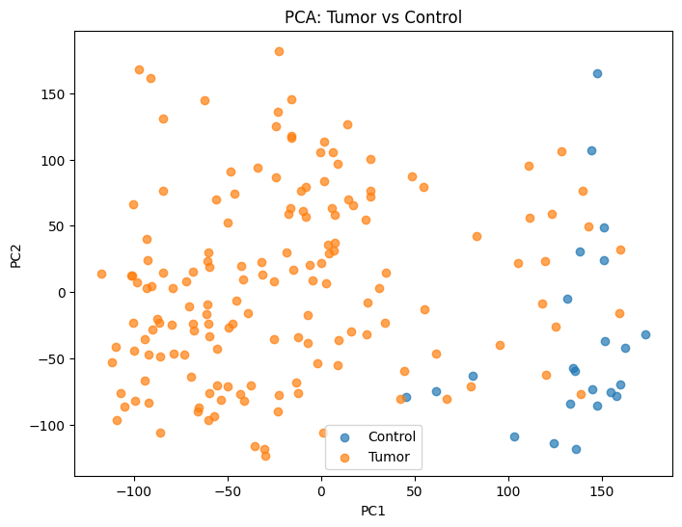
Principal Component Analysis (PCA)
• Reduces high-dimensional data into fewer components
• Transforms correlated variables into orthogonal components
• Reduced ~54,613 genes → 149 components
• Retained 95% of total variance
• Helps reduce noise and improve model performance
PCA projection demonstrates clear separation between tumor and control samples.

Slide 10
Feature Selection: Variance Filtering
• Selects genes with highest variance across samples
• High-variance genes are more informative
• Top 1000 most variable genes selected
• Reduces noise while preserving interpretability
• Improves model performance and interpretability

Slide 11
Classification Models
• Logistic Regression
• Support Vector Machine (SVM)
• Random Forest
• Compared under stratified 5-fold cross-validation
• Linear SVM achieved highest performance

Slide 12
Model Performance Comparison
Model | Accuracy (Mean ± SD) | ROC-AUC
Linear SVM | 98.9% ± 1.36% | 0.996
Logistic Regression | 97.0% ± 3.4% | 1.000
Random Forest | 92.0% ± 4.2% | 1.000
RBF SVM | 92.8% ± 3.3% | 0.989
Linear SVM achieved the highest cross-validated accuracy

Slide 13
Model Evaluation Metrics
• Sensitivity (TPR): 0.975
• Specificity (TNR): 1.000
• Sensitivity: Correctly identifies tumor samples
• Specificity: Correctly identifies control samples
• Indicates high classification reliability

Slide 14
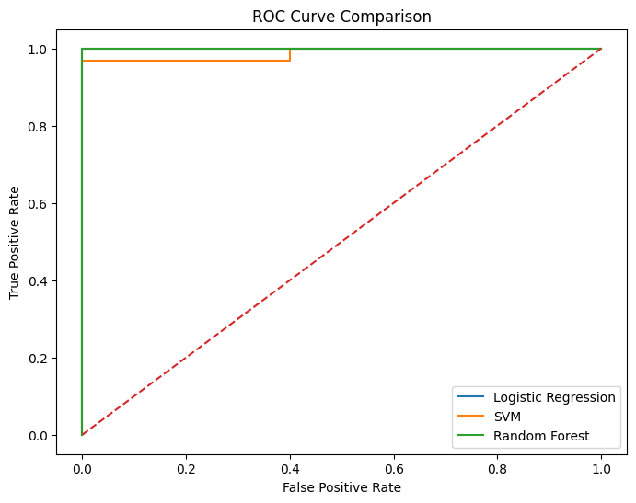
ROC Curve & AUC
• ROC curve shows trade-off between sensitivity and specificity
• Evaluates model performance across different thresholds
• Mean ROC-AUC: 0.996 ± 0.008
• AUC close to 1 indicates excellent classification
All models show strong performance with curves near the top-left,
and AUC close to 1 indicates excellent classification ability.

Slide 15
Stability Selection
• Identifies consistently selected genes across resampling
• Based on L1-regularized logistic regression
• Genes selected with frequency ≥ 0.8
• Ensures robustness and reproducibility
• Key genes identified:
SOX2, MSI2, CDK17, RAB40B, PRKCZ
• Selected genes show strong statistical and biological relevance

Slide 16
Interpretation of Results
• Significant differential expression observed between tumor and control
• Large effect sizes indicate strong separation
• High classification accuracy under cross-validation
• Linear SVM performed best in high-dimensional setting
• Stable genes identified show biological relevance

Slide 17
Limitations
• No external validation dataset
• Class imbalance (157 vs 23 samples)
• Microarray platform limitations
• Analysis is correlational, not causal
• Tumor subtypes aggregated into one class

Slide 18
Conclusion
• Gene expression data shows strong separation between tumor and control
• Significant differential expression with large effect sizes
• Linear SVM achieved highest performance
• High accuracy and ROC-AUC indicate reliable classification
• Identified stable and biologically relevant genes
• Results demonstrate structured and reproducible patterns in
high-dimensional gene expression data.

Slide 19
Future Work
• Validation using independent datasets
• Use of RNA-sequencing data for improved accuracy
• Subtype-specific classification of glioma
• Integration of multi-omics data
• Pathway and gene set analysis

Slide 20
